Slide 1

राष्ट्रीय प्रौद्योगिकी संस्थान पुदुच्चेरी
NATIONAL INSTITUTE OF TECHNOLOGY PUDUCHERRY
(An Institute of National Importance under MoE, Govt. of India)
KARAIKAL – 609 609
Final Year project - Second Review Meeting
AI Based Design for Frequency Selective Surface (FSS)
Project Guide
Dr. Boopathi Rani R
Assistant Professor,
Depatment of ECE,
NIT Puducherry, Karaikal,
India
Presented by
KAPA ADHEESHWAR REDDY
Reg No: EC21B1023
SADHU POORNA SAI
Reg No:EC21B1043
SANAPALA CHANDRA SEKHAR
Reg No:EC21B1044
B.TECH Department of ECE,
NIT Puducherry, Karaikal,
India

Slide 2
Introduction:
What is Frequency Selective Surfaces (FSS)?
Frequency Selective Surfaces (FSS) are specialized structures used in modern wireless communication systems.
They play a crucial role in filtering, controlling, and modifying electromagnetic waves.
Applications of FSS:
FSS is used to enhance the performance of antennas by filtering specific frequencies.
FSS helps in shielding electronic devices from unwanted electromagnetic interference.
FSS structures are integral in managing signal propagation and improving overall system efficiency.
Challenges in FSS Design:
Traditional Design Methods: Designing FSS typically involves iterative processes that are computationally expensive and time-consuming.
Complexity: Achieving the desired electromagnetic properties through traditional methods requires significant expertise and resources.

Slide 3
Problem Statement:
Designing FSS with specific electromagnetic properties traditionally requires significant computational resources, expertise, and time. Additionally, managing large datasets for AI-driven designs is a challenge. The need arises for more efficient, data-driven models that maintain high accuracy while reducing the computational load. This project aims to develop AI-based models that address these challenges, improving the design efficiency of FSS for applications in wireless communication, antenna design, and electromagnetic shielding.
Objectives:
Develop an AI-Based FSS Design Framework: Implement an efficient design method for Frequency Selective Surfaces (FSS) using a deep neural network-based to predict transmission coefficients.
Enhance Optimization Efficiency: Integrate the Optimization algorithm with the deep neural network to iteratively optimize FSS structural parameters, achieving faster convergence with high accuracy.
Improve Design Accuracy: Achieve accurate FSS design results by minimizing errors in transmission coefficients at key frequency points.
Reduce Computational Time: Increase design efficiency compared to traditional methods, making FSS design faster and more adaptable for practical applications.

Slide 4
Methodology:
Data Preprocessing Simulation datasets with structural parameters ( l1 , l2 , l3) and S21 values were imported and grouped to form a consolidated dataset for training and analysis.
Feature and Target Preparation Structural parameters were used as input features, while S21 values, converted from dB, served as the target output. The data was then split into training and testing sets for model validation.
Network Design (FPN) A deep neural network with multiple dense layers and LeakyReLU activation functions was built. This model, trained on the dataset, learned the relationship between structural parameters and S21 values, enabling accurate frequency response predictions.

Slide 5
Optimization (IPSO) The IPSO algorithm was used to optimize structural parameters for target S21 values at specific frequencies. IPSO adjusted particle velocities and positions to find optimal parameters that align with desired S21 values.
Target S21 Definition Target S21 values were interpolated across the frequency range .
Optimization and Fitness Evaluation IPSO ran for 200 iterations, optimizing structural parameters by minimizing the difference between predicted and target S21 values.
Results and Visualization The optimized parameters were used with the FPN model to predict S21 values, which were then plotted against target values for a visual comparison of design accuracy and model performance.

Slide 6
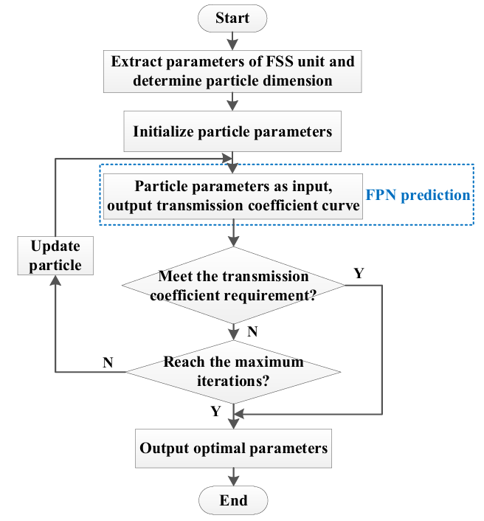
Flow Chart
Fig(1).Flow Chart for the Construction of Model

Slide 7
What is FPN?
A forward prediction network is a neural network designed to predict future values in a sequence using historical data.
Replaces traditional, computationally heavy simulations, enabling faster FSS performance predictions.
Maps FSS structural parameters to their transmission responses, accelerating the design process while ensuring accuracy.
Composed of dense layers with LeakyReLU activations to capture complex, non-linear relationships.
Outputs predictions in a linear scale, simplifying training and achieving smoother prediction curves.
Facilitates rapid, efficient design iterations, significantly enhancing FSS adaptability and design efficiency.

Slide 8
What is IPSO?
Improved Particle Swarm Optimization (IPSO) is an enhanced version of the Particle Swarm Optimization (PSO) algorithm, designed for optimizing FSS parameters.
Uses adaptive inertia weights and dynamic learning coefficients to balance exploration and exploitation.
Enables particles to converge quickly on the optimal solution by strengthening global and local search abilities.
Iteratively adjusts FSS structural parameters to align with target transmission characteristics with high precision.
Improves both convergence speed and optimization accuracy, compared to basic PSO.
Provides a powerful, efficient solution for rapid, accurate FSS design optimization.

Slide 9
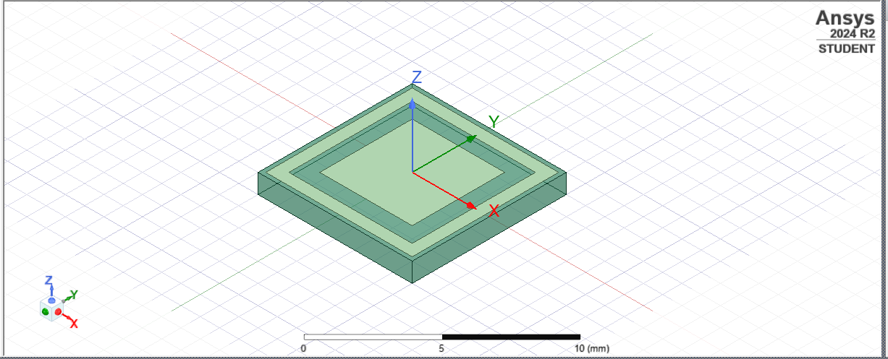

Frequency Selective Surfaces (FSS) Design :
Fig(2).Simulation Image of FSS in HFSS Software
Copper
Substrate

Slide 10


Results
Performance: The FPN model achieved Mean Squared Error (MSE) and Validation Loss within acceptable limits, indicating good predictive accuracy for S21 values.
Key Outcomes:
The plot of predicted S21 values closely align, confirming high prediction accuracy.
The use of IPSO for parameter optimization improved the model’s performance by accurately tuning structural parameters to meet target S21 values at specified frequencies.
Output:
S21 Prediction Results
Final Training Loss: 14.633203506469727
Final Validation Loss: 14.026500701904297
Optimal FSS parameters
(L1, L2, L3): [2.800000 3.462830 2.000000]
Fig(3).Output of the Model (Optimal Parameters)

Slide 11
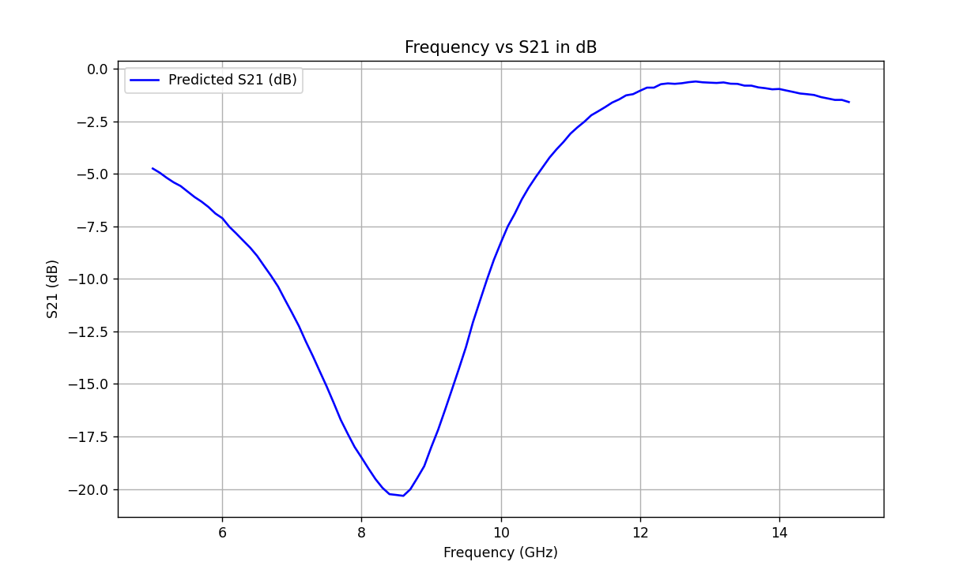
Visualization :
Fig(4). Visualization of Frequency(GHz) vs S21 of Predicted Values (dB)

Slide 12
Conclusion :
Effectiveness of AI: AI demonstrated strong potential in automating and enhancing the design process for Frequency Selective Surfaces (FSS), showing high accuracy in predicting frequency responses.
Optimization Capabilities: The developed Forward Prediction Network (FPN) and IPSO-based optimization provide a reliable framework for optimizing structural parameters, minimizing design iterations, and increasing adaptability to target specifications.
Streamlined Process: This AI-driven approach significantly simplifies the FSS design workflow, enabling efficient alignment with precise performance targets.
Feasibility and Accuracy: The close alignment between actual and predicted values validates the effectiveness of machine learning for automating and refining FSS design, ensuring both feasibility and accuracy in real-world applications.

Slide 13
References :
R. Cong, C. Zhang, N. Liu, K. Yang, X. Gao, and X. Sheng, "A Novel Method for Frequency Selective Surface Design Using Deep Learning with Improved Particle Swarm Algorithm," 2022 IEEE the 9th International Symposium on Microwave, Antenna, Propagation and EMC Technologies for Wireless Communications (MAPE), 2022, pp. 374-379, doi: 10.1109/MAPE53743.2022.9935221.
Thank You

